Slide 1

SOCCER BOT
Robotics Lab Project
Adil Naz Muhammed
Roll Number 1

Slide 2
Overview
Robot pursues ball using camera vision
Tele-op control based gaming
Realistic soccer field simulation in Gazebo
Ball-tracking and movement control via ROS

Slide 3
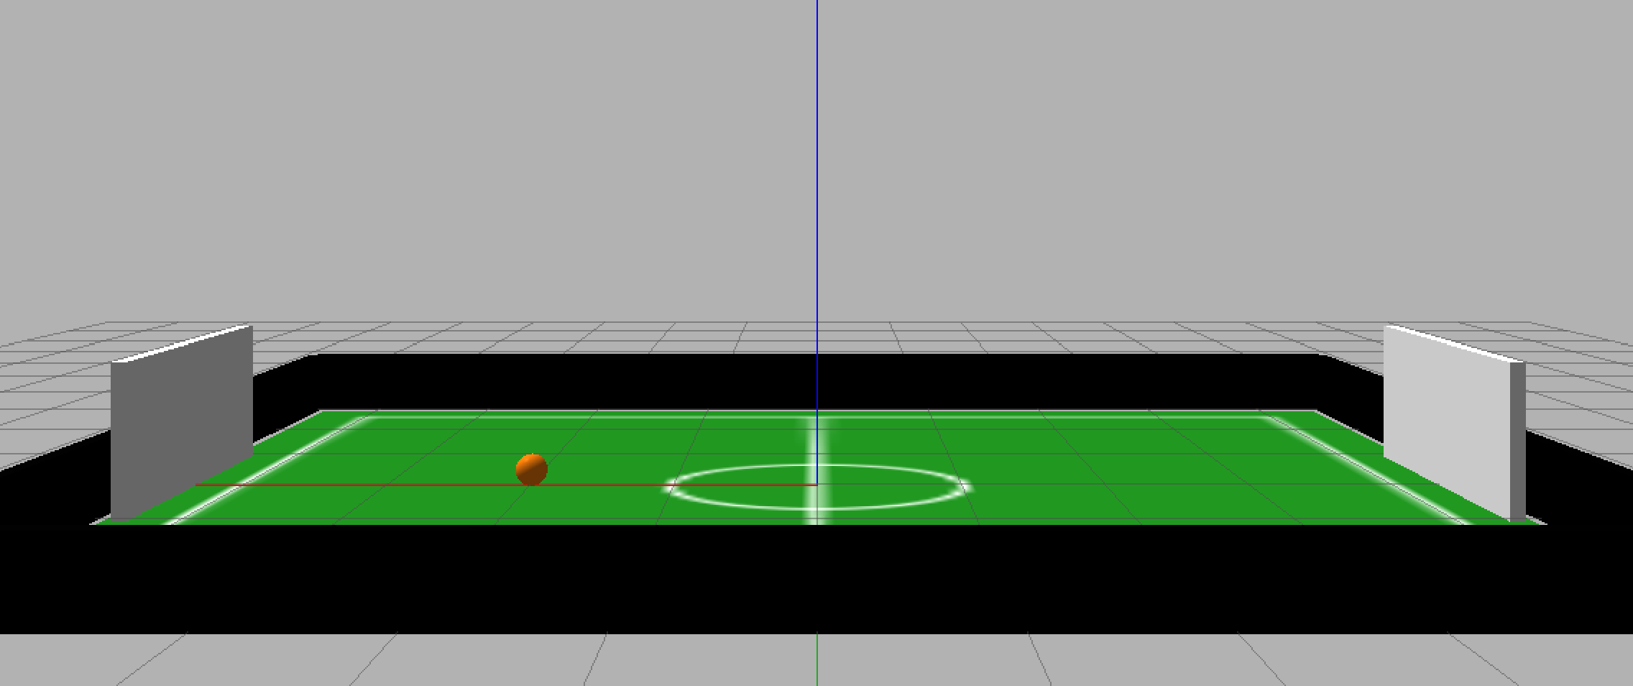
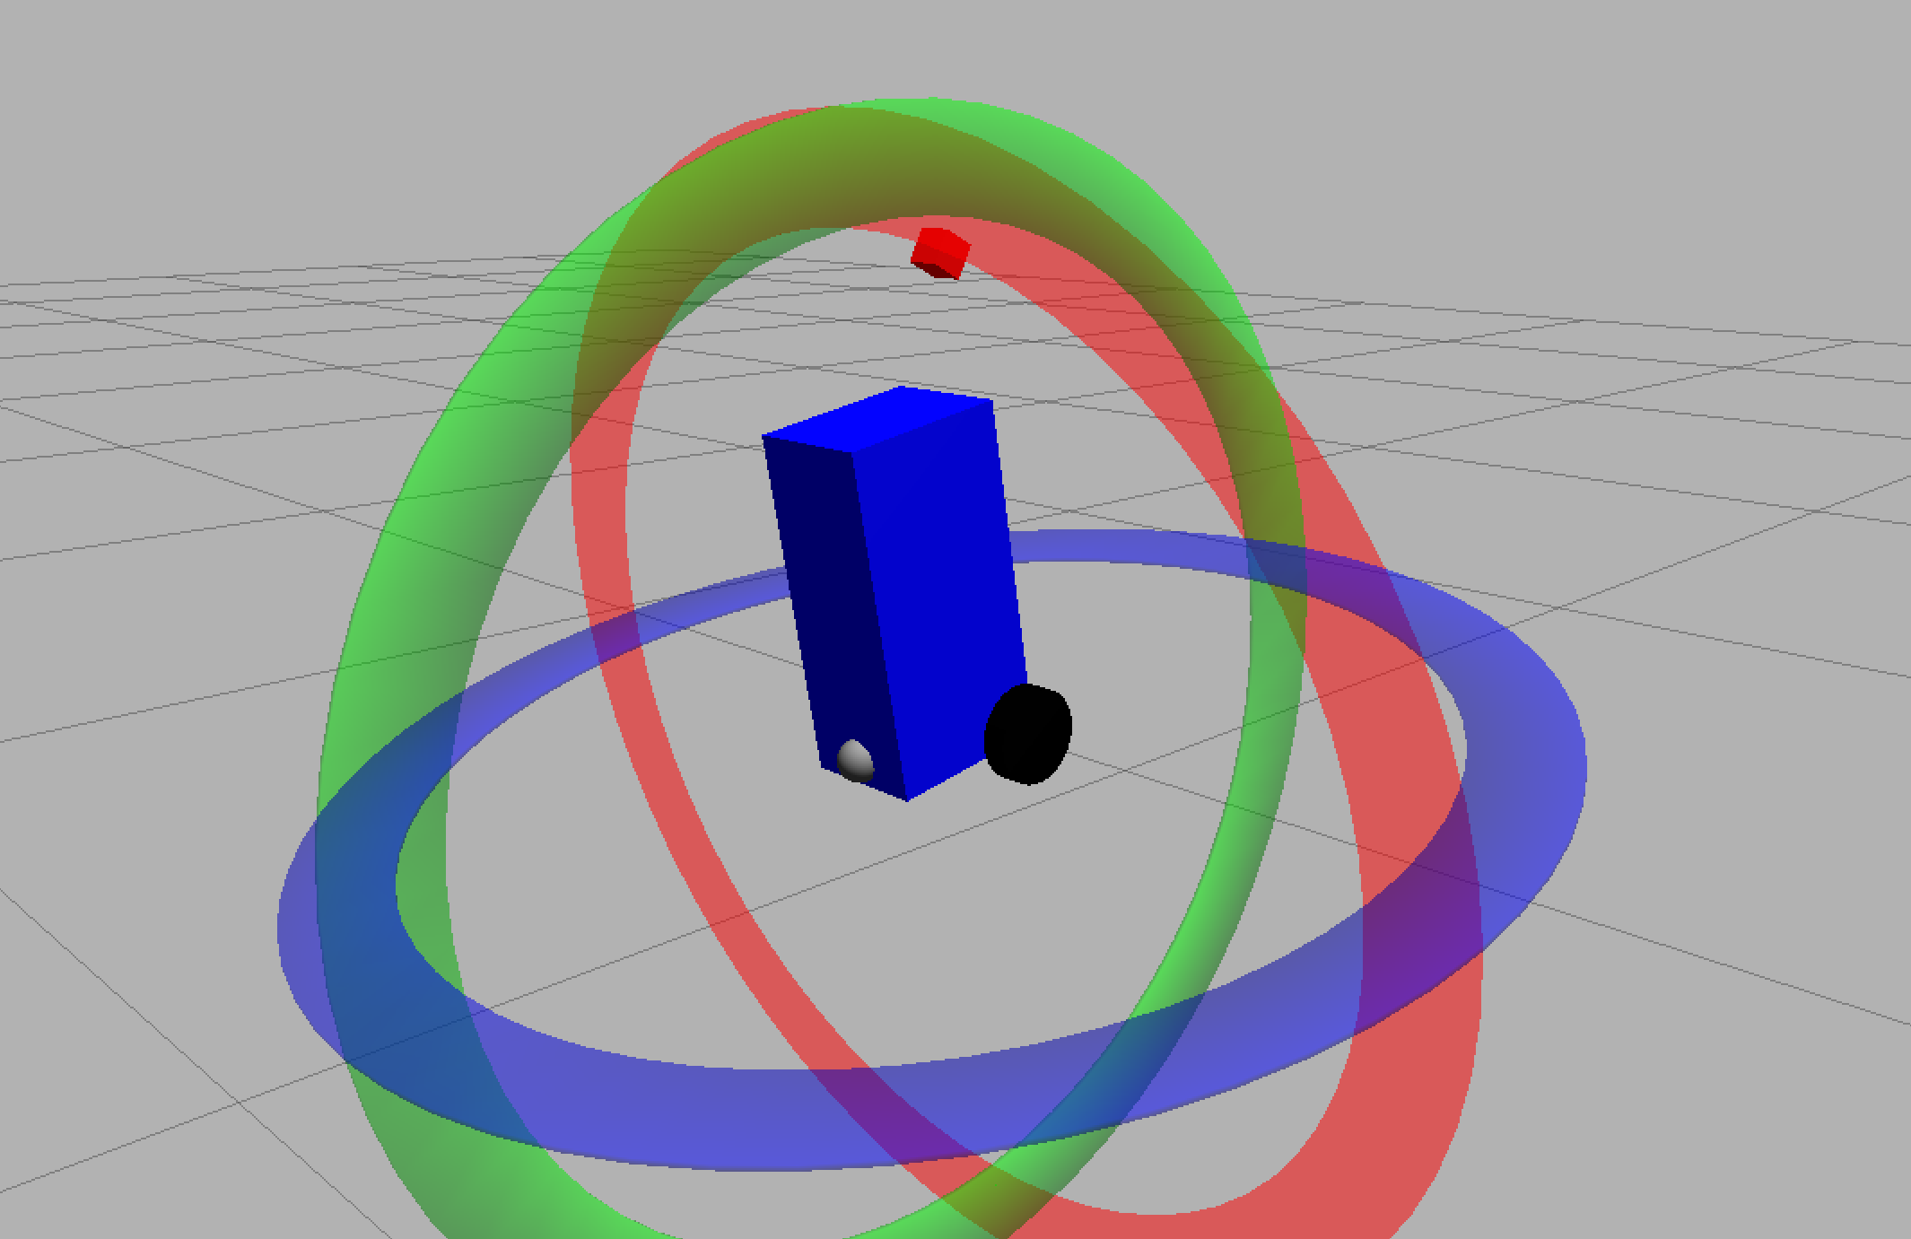
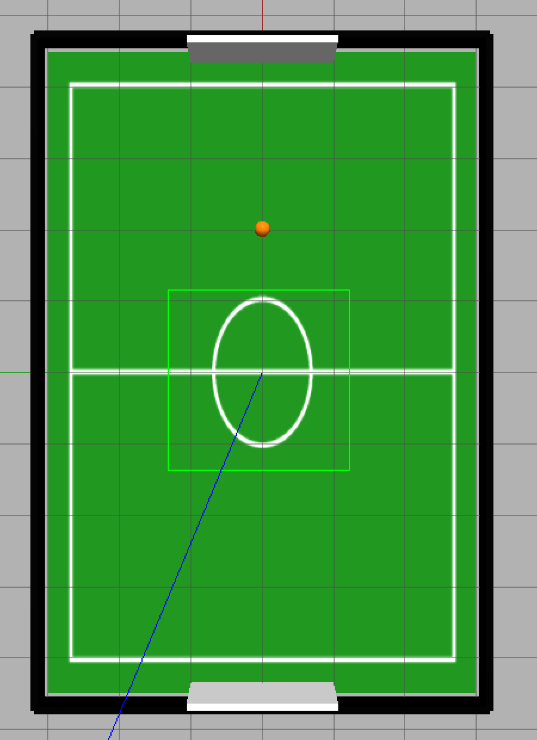
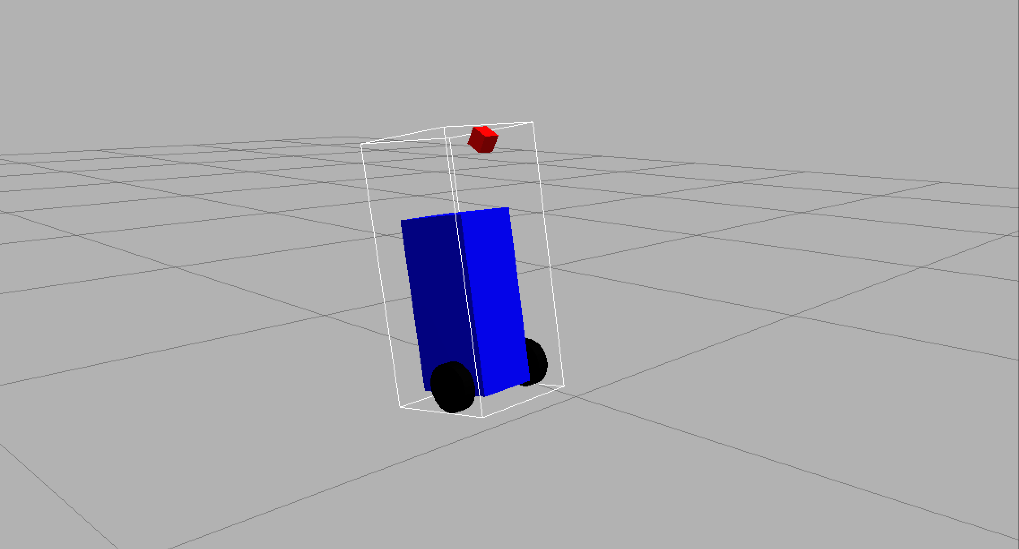
Robot Architecture (URDF) and Environment
Base, left & right wheels, rear caster
Forward-mounted tilt camera
Gazebo ROS camera plugin for image topics
Diff-drive plugin for motion control
9 × 6 meter realistic soccer field
High-resolution textured field surface
Walls on all four sides
Goals placed on long edges
Dynamic soccer ball model

Slide 4
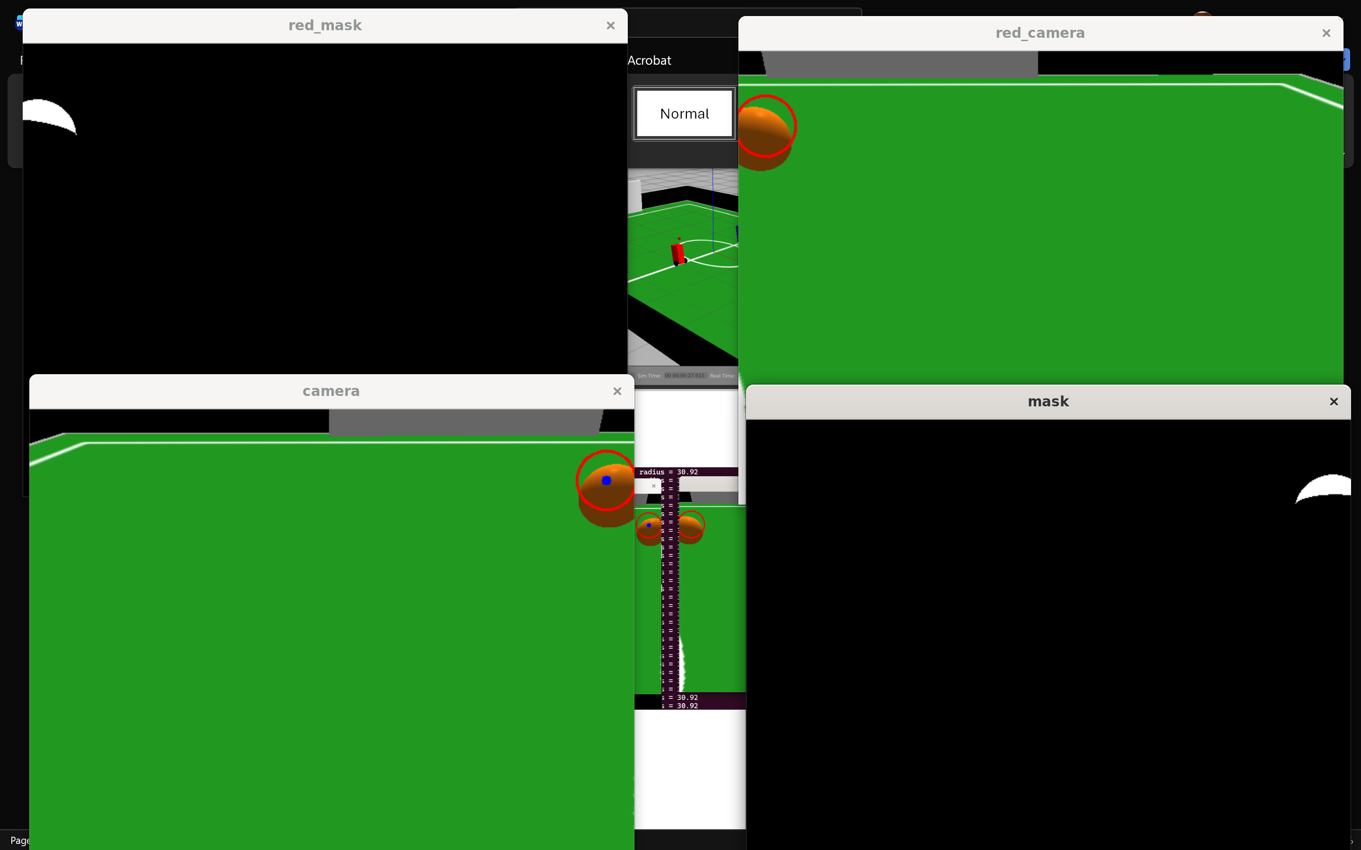
Computer Vision System
HSV mask for orange-ball detection
Noise filtering: morphological open/close
Contour extraction and radius estimation
Adaptive control based on ball position
Ball Following Controller (ROS Node)
Goal & Wall Awareness
White/Grey color detection for goal posts
Goal scored when ball passes post line
Optional reset-to-center logic
Prevents the robot from leaving field bounds
Reads camera feed from /soccerbot_cam
Computes angular correction using horizontal error
Speed reduces as robot nears the ball
Search mode: rotate and reverse when lost

Slide 5
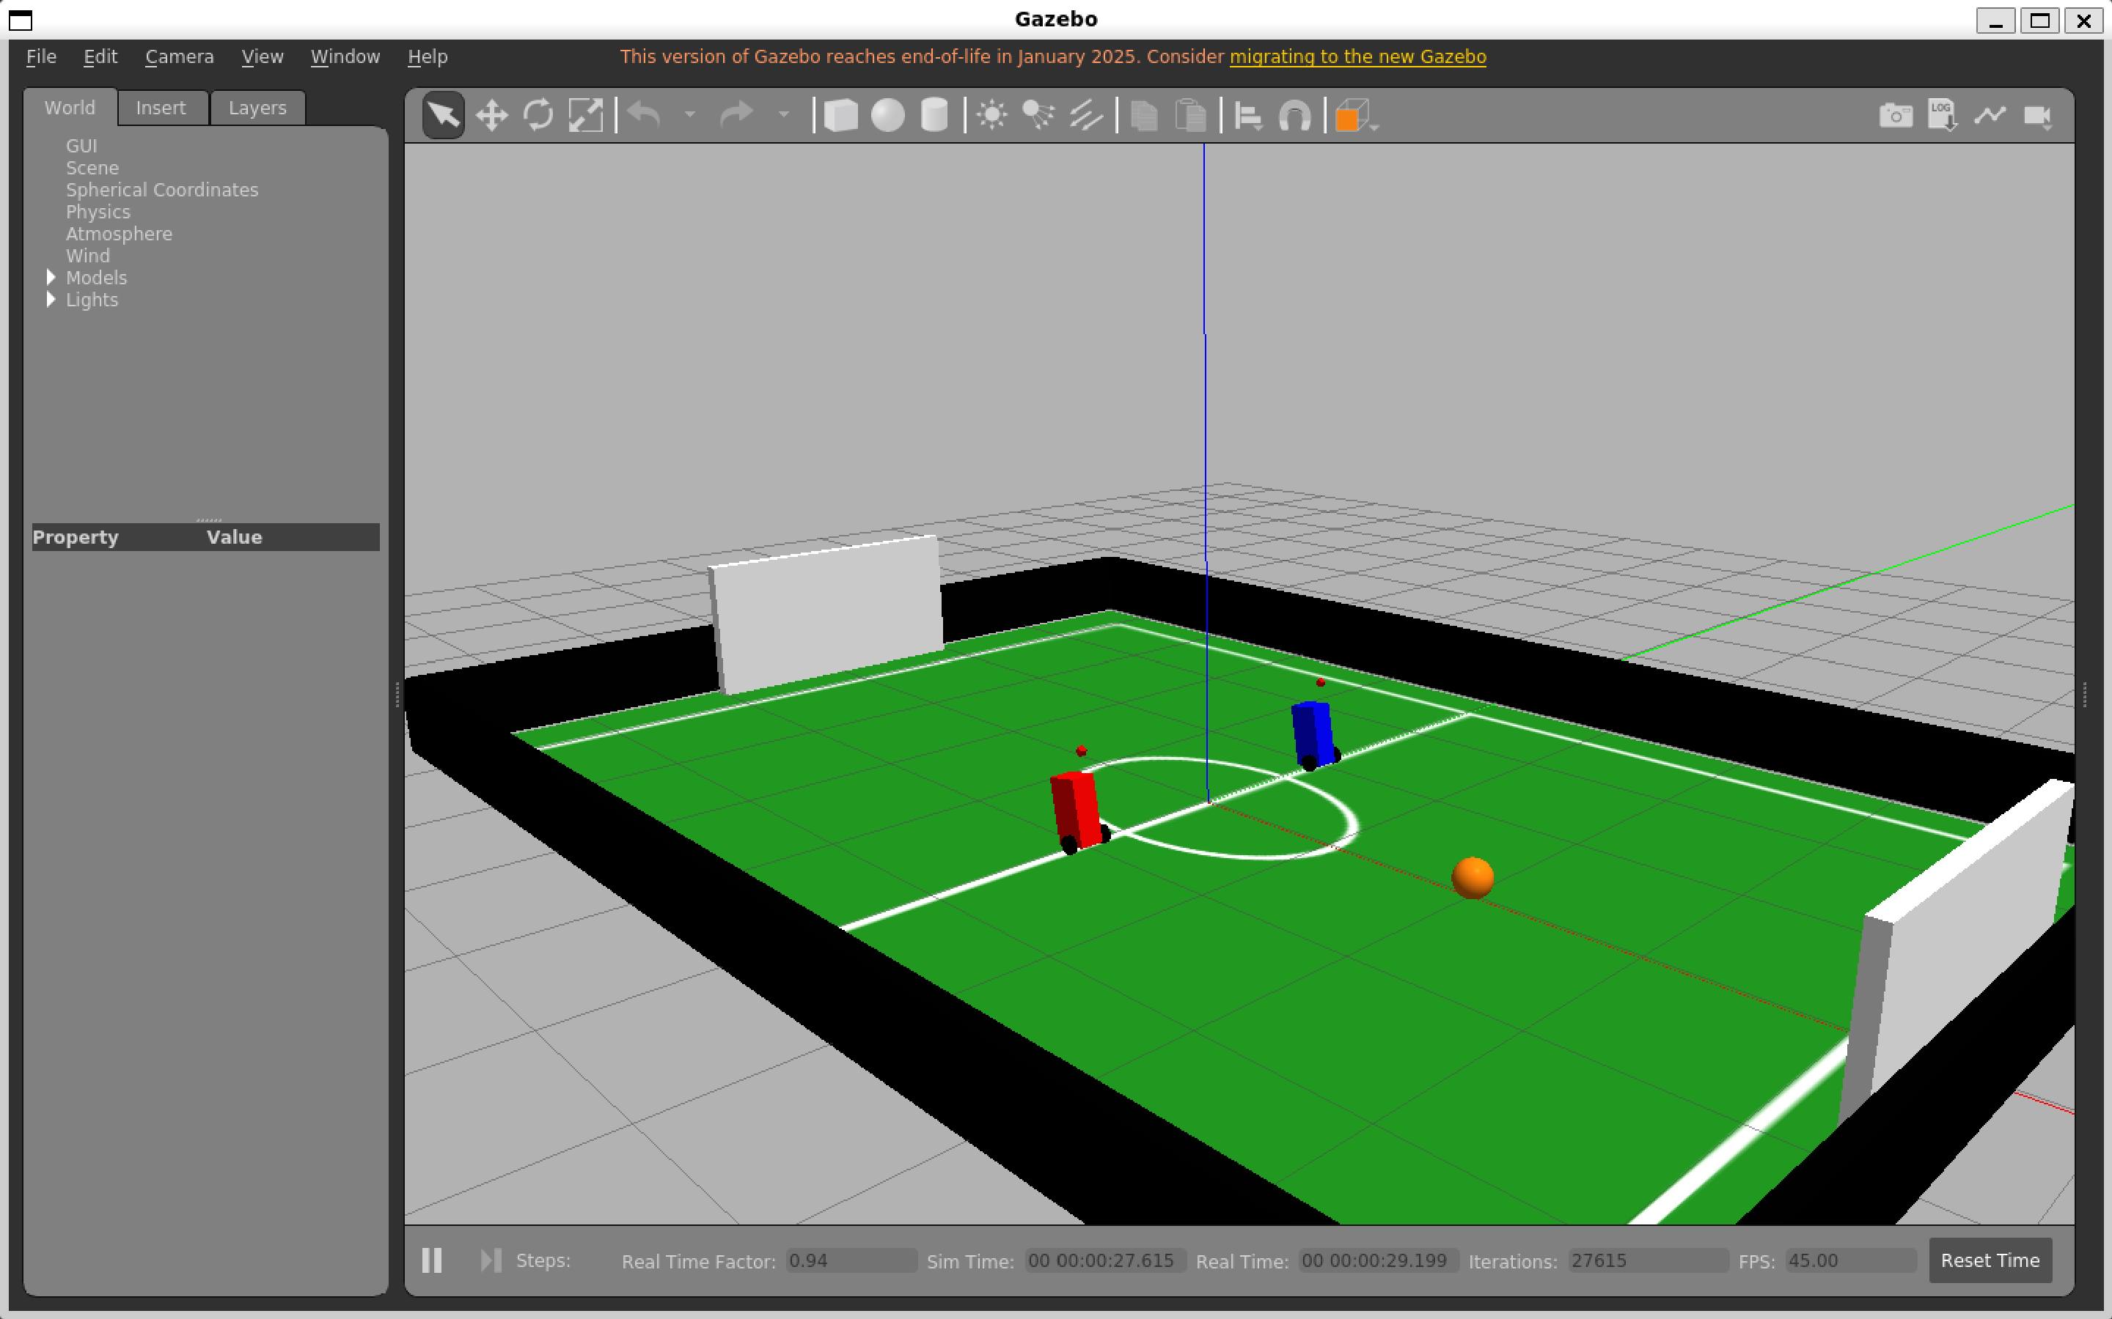
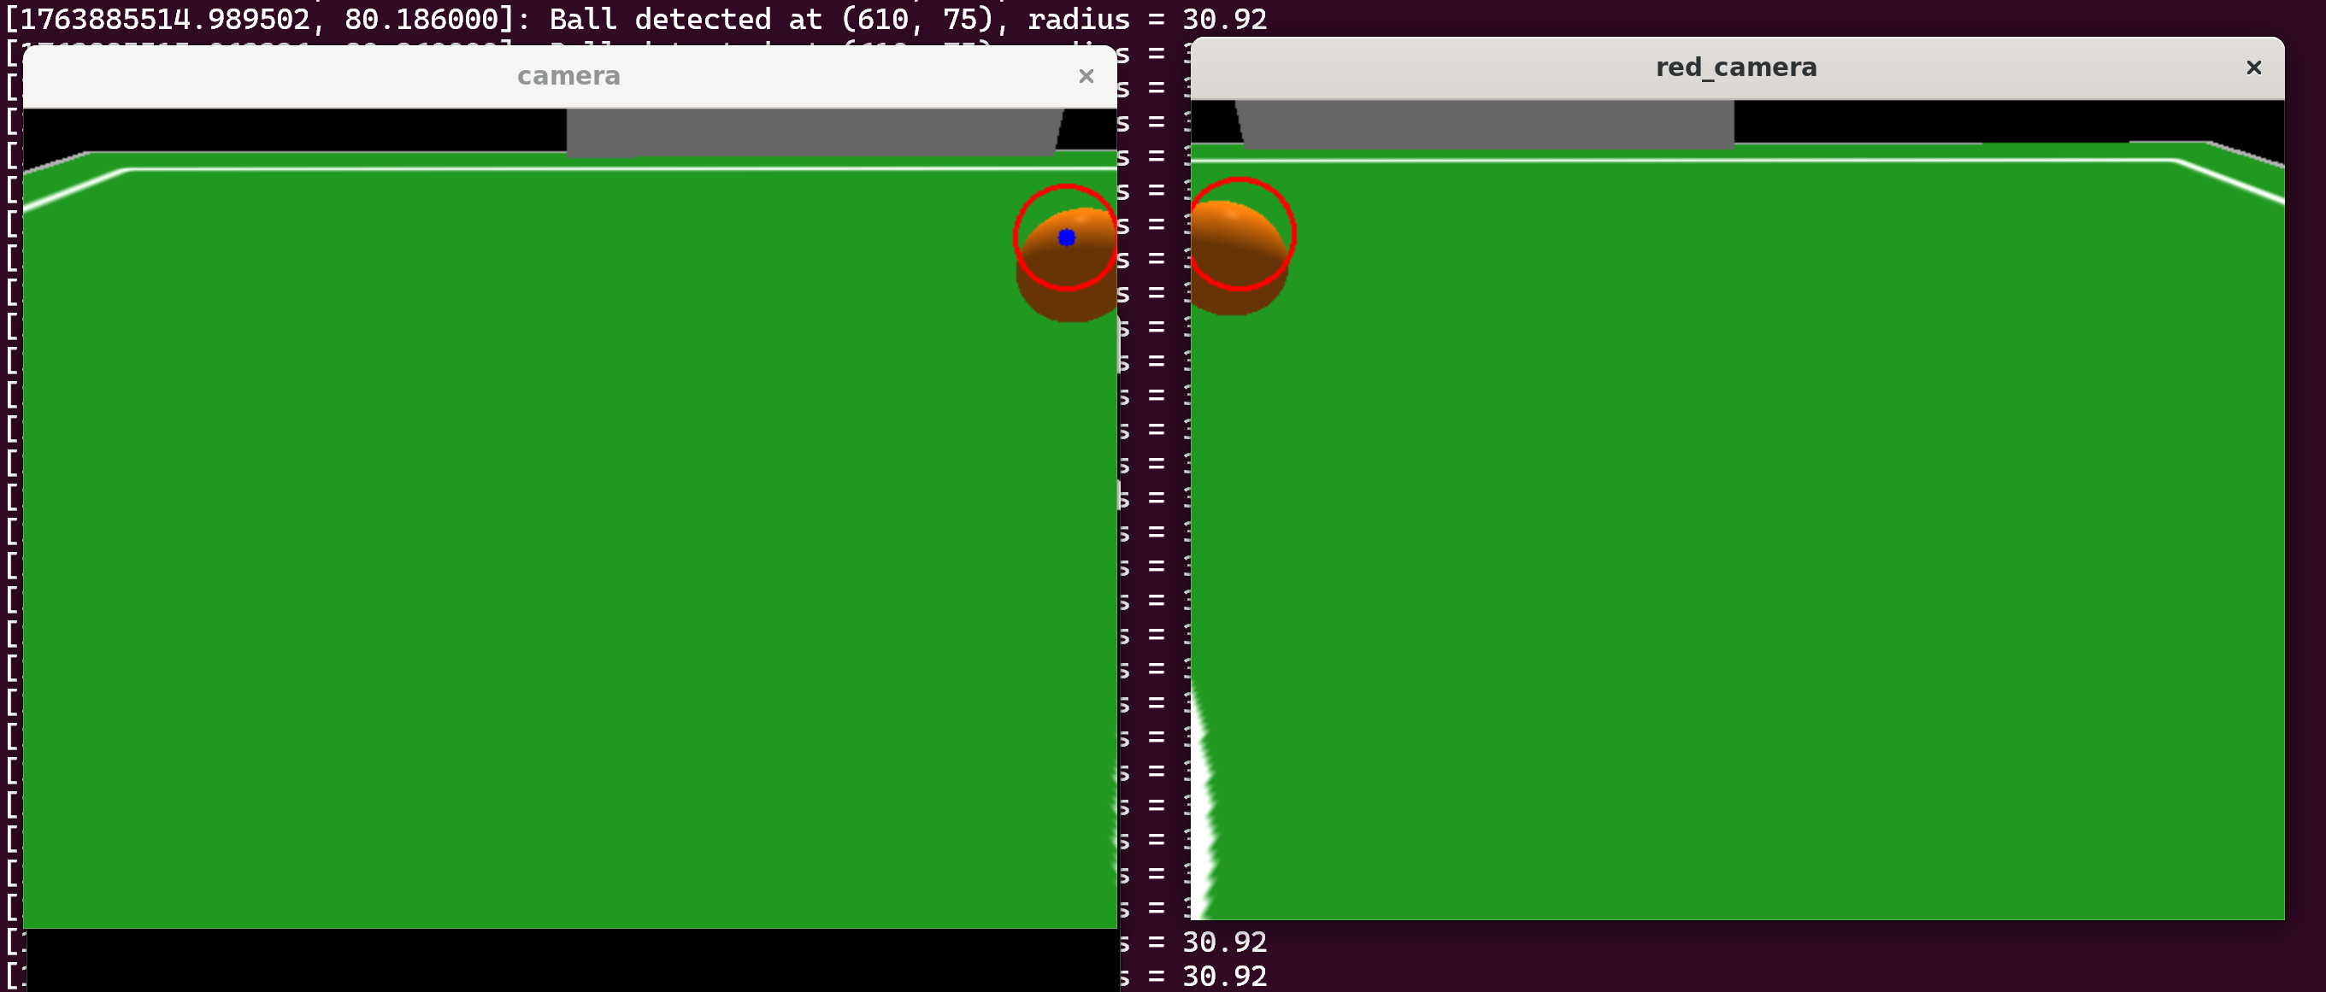
Two Player Mode
Launching a second URDF model into the world
Since terminal signal is limited, imported pygame for seamless command
WASD teleop for player 1 and arrow key teleop for player 2

Slide 6
Future Additions
Goal detection
Sideline / boundary detection
Field awareness (goal + boundaries mapped)
Robot states (real soccer logic)
Improved kicking/pushing behavior
Physics tuning (ball & robot)

Slide 7
Thank You

